Slide 1
Feature Engineering

Slide 2
overview
What is feature engineering ?
What is feature scaling ?
Techniques for feature scaling
When to use the various feature scaling techniques
What is feature selection?
Methods for feature selection
When to use a particular feature selection method

Slide 3
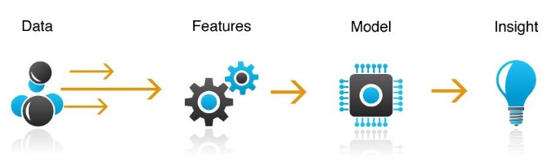
What is Feature Engineering?
A process of selecting and transforming variables when creating a predictive model using machine learning or statistical tools
Involves a combination of data analysis, applying rules of thumb and judgement
Helps to get most out of your data for your algorithm to work with
More flexible and simple models
Techniques: feature scaling, feature selection

Slide 4
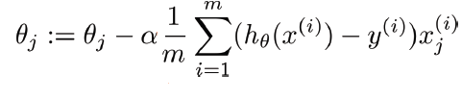

What is Feature Scaling?
A technique used to put values of a particular feature in the same range so that no feature is dominant over the other when predicting model results
Why do we scale features?
Gradient descent-based algorithms, e.g., linear regression, logistic regression, neural networks
Distance-based algorithms, e.g., KNN, K-means, SVM

Slide 5


Techniques for Feature Scaling
Standardization: a scaling technique where the values are centered around the mean with a unit standard deviation. It transforms your data such that the resulting distribution has a mean of 0 and a standard deviation of 1.
Normalization: a scaling technique in which values are shifted and rescaled so that they end up ranging between 0 and 1. It is also known as Min-Max scaling.

Slide 6
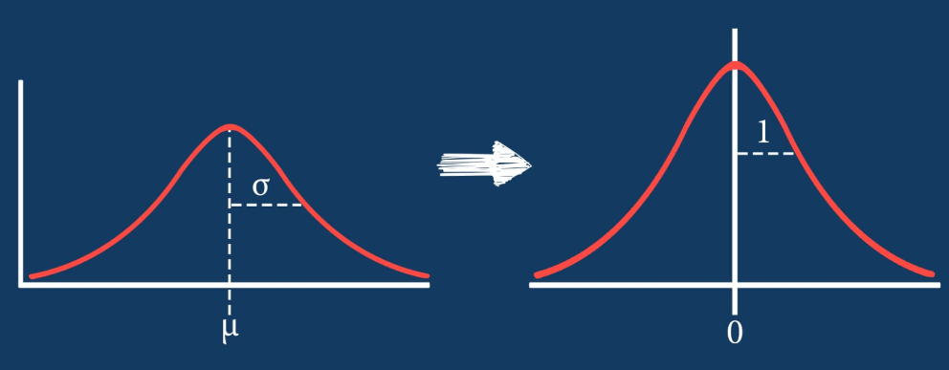
Normalize or Standardize?
Normalize when:
Data does not follow a Gaussian/normal distribution
Using algorithms like KNN and Neural Networks that do not assume any distribution of the data
Standardize when:
Data follows a Gaussian distribution
Have outliers in your data since it does not have a bounding range

Slide 7

What is Feature Selection?
A technique that helps to reduce the number of input variables when developing a predictive model. Primarily focused on reducing non-informative and redundant predictors from models.
Helps reduce computational cost of model, and sometimes improve model performance.
Why do we select features?
Many models, especially those based on regression slopes and intercepts, will estimate parameters for every term in the model. Because of this, the presence of non-informative variables can add uncertainty to the predictions and reduce the overall effectiveness of the model.

Slide 8
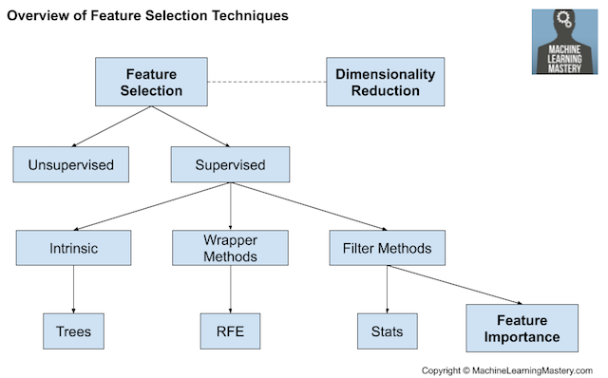
Techniques for Feature Selection

Slide 9
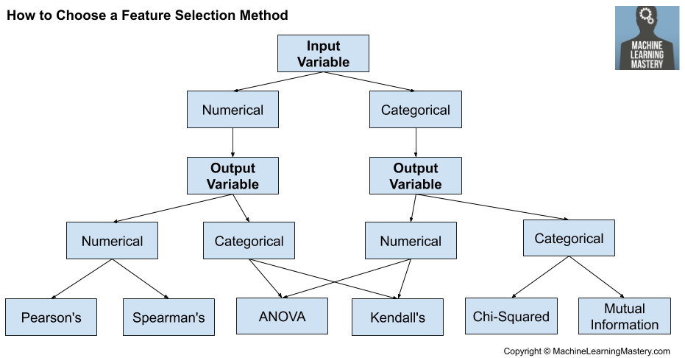
Choosing a Feature Selection Method

Slide 10
Filtering Methods(Scikit Learn)
SelectKBest: select the top k variables
SelectPercentile: select the top percentile variables

